Slide 1
Computer simulation in Condensed matter physics: from idealised models to ab-initio methods
Pietro Ballone
Physics Department, NTNU, Trondheim, and
Italian Institute of Technology, Rome, Italy
Main interests:
Investigate equilibrium and non-equilibrium properties of
classical and quantum many-particle systems by
computer simulation
Compute structural, dynamical and electronic properties
of molecules, liquids and solids.

Slide 2
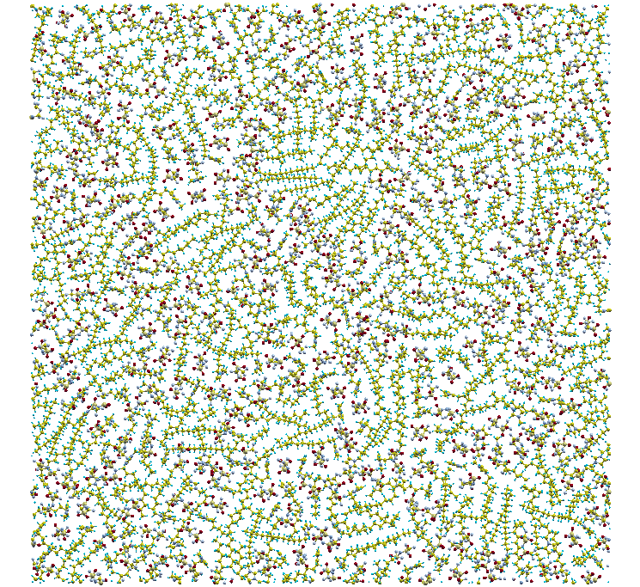
Organic ionic films on solid surfaces:
innovative “green” lubricants

Slide 3
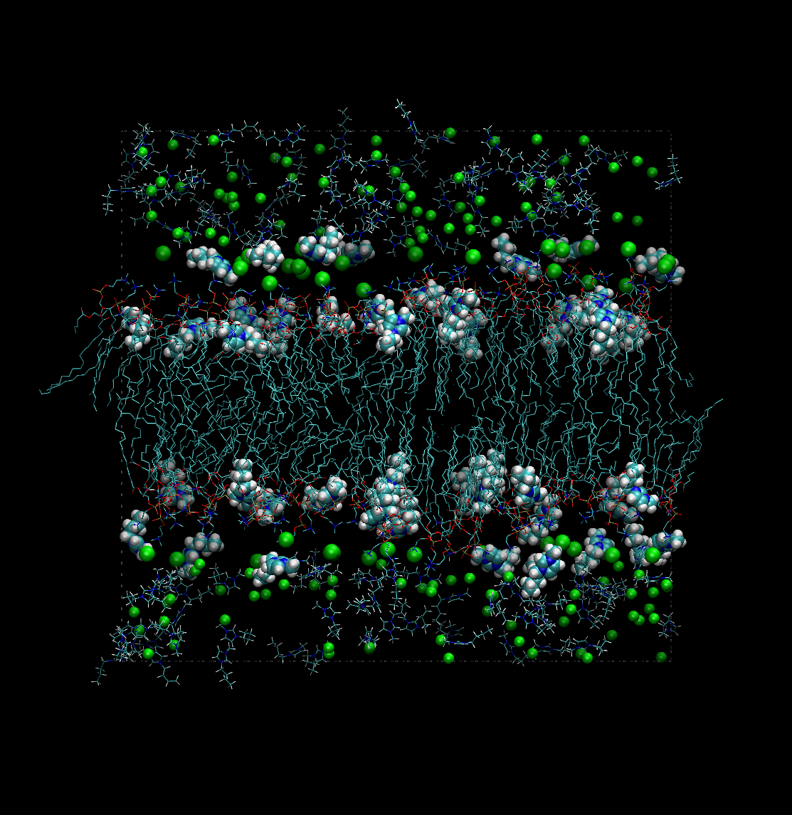
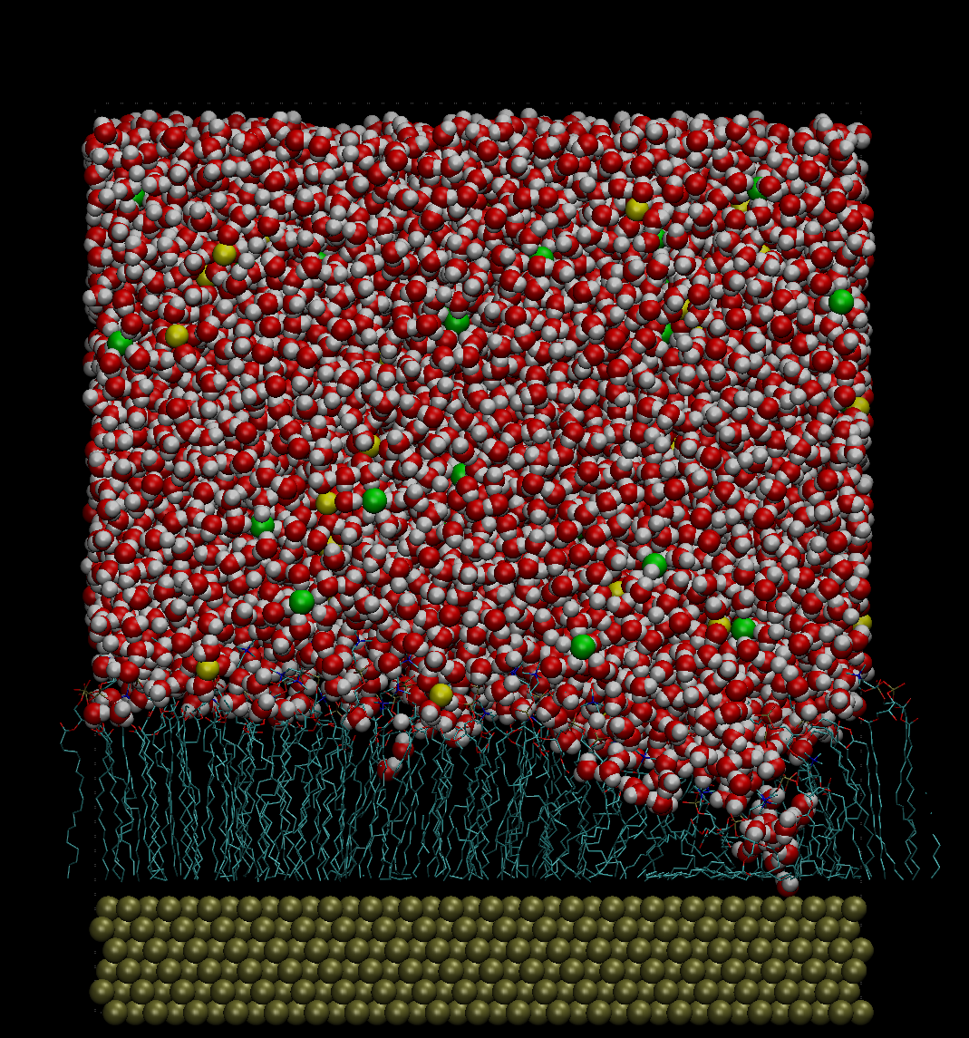
Lipid bilayers in electrolyte solutions and at surfaces

Slide 4
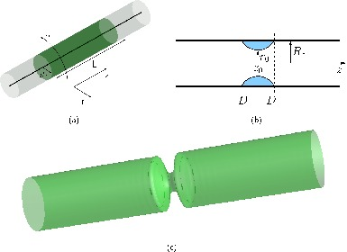
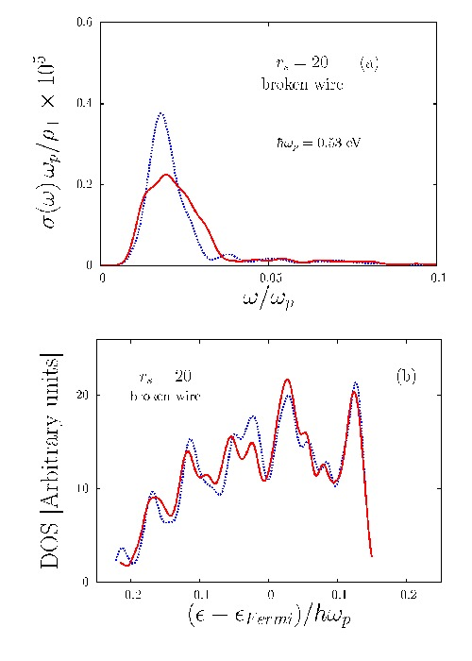
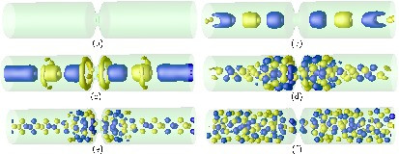
Spin polarisation and charge localisation in metal nanowires

